Slide 1

Heisenberg realized that ...
In the world of very small particles, one cannot measure any property of a particle without interacting with it in some way
This introduces an unavoidable uncertainty into the result
One can never measure all the
properties exactly
Werner Heisenberg (1901-1976)
Image in the Public Domain

Slide 2

Measuring Position and Momentum of an Electron
Shine light on electron and detect
reflected light using a microscope
Minimum uncertainty in position
is given by the wavelength of the light
So to determine the position
accurately, it is necessary to use
light with a short wavelength
BEFORE
ELECTRON-PHOTON
COLLISION
incident
photon
electron

Slide 3

Measuring Position and Momentum of an Electron
By Planck’s law E = hc/λ, a photon with a
short wavelength has a large energy
Thus, it would impart a large ‘kick’ to the electron
But to determine its momentum accurately,
electron must only be given a small kick
This means using light of long wavelength !
AFTER
ELECTRON-PHOTON
COLLISION
scattered
photon
recoiling
electron

Slide 4
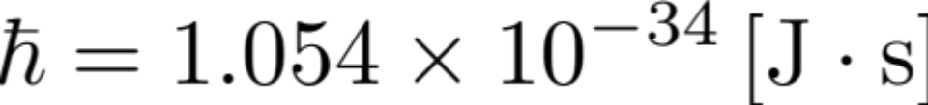
Implications
It is impossible to know both the position and momentum exactly, i.e., Δx=0 and Δp=0
These uncertainties are inherent in the physical world and have nothing to do with the skill of the observer
Because h is so small, these uncertainties are not observable in normal everyday situations

Slide 5
Example of Baseball
A pitcher throws a 0.1-kg baseball at 40 m/s
So momentum is 0.1 x 40 = 4 kg m/s
Suppose the momentum is measured to an accuracy
of 1 percent , i.e.,
Δp = 0.01 p = 4 x 10⁻² kg m/s

Slide 6
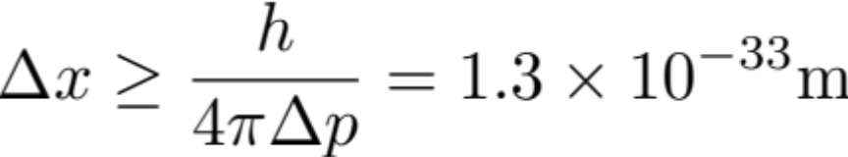
Example of Baseball (cont’d)
The uncertainty in position is then
No wonder one does not observe the effects of the uncertainty principle in everyday life!

Slide 7
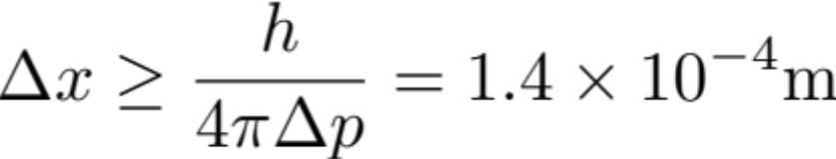
Example of Electron
Same situation, but baseball replaced by an electron which has mass 9.11 x 10⁻³¹ kg traveling at 40 m/s
So momentum = 3.6 x 10⁻²⁹ kg m/s
and its uncertainty = 3.6 x 10⁻³¹ kg m/s
The uncertainty in position is then

Slide 8
Wavefunction
Quantum mechanics acknowledges the wave-particle duality of matter by supposing that, rather than traveling along a definite path, a particle is distributed through space like a wave. The wave that in quantum mechanics replaces the classical concept of particle trajectory is called a wavefunction, ψ (“psi”).

Slide 9
A wave function in quantum mechanics describes the quantum state of an isolated system of one or more particles. There is one wave function containing all the information about the entire system, not a separate wave function for each particle in the system.

Slide 10
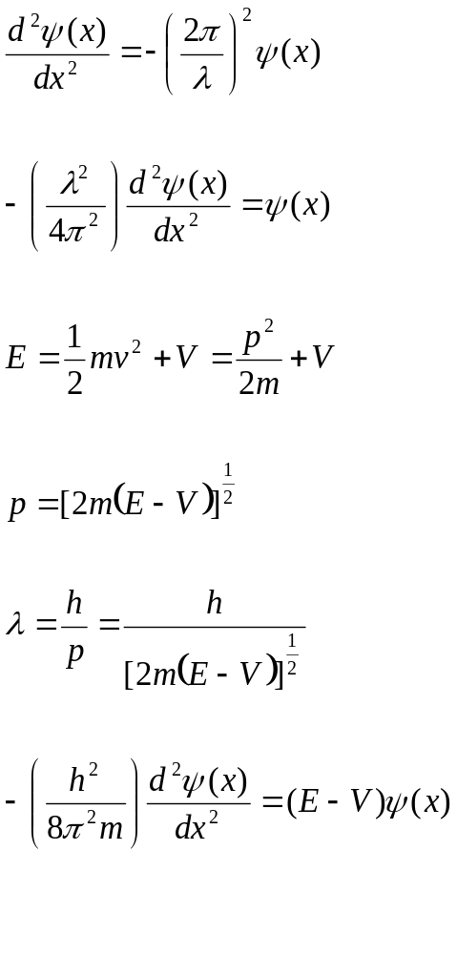
Wave equation for the harmonic motion

Slide 11
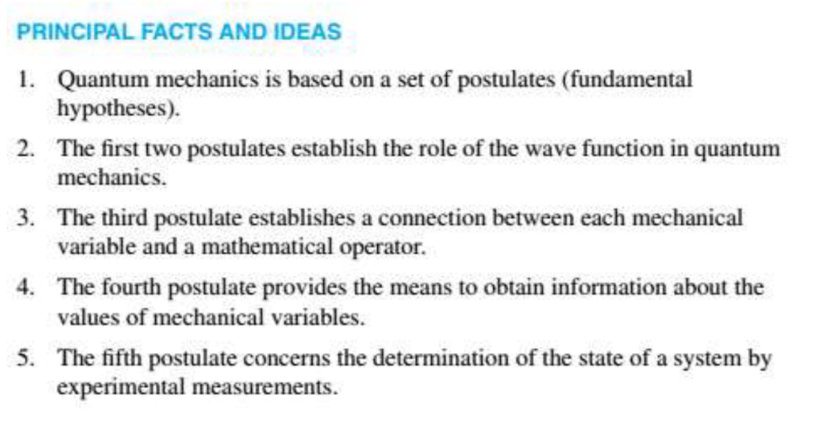

Slide 12
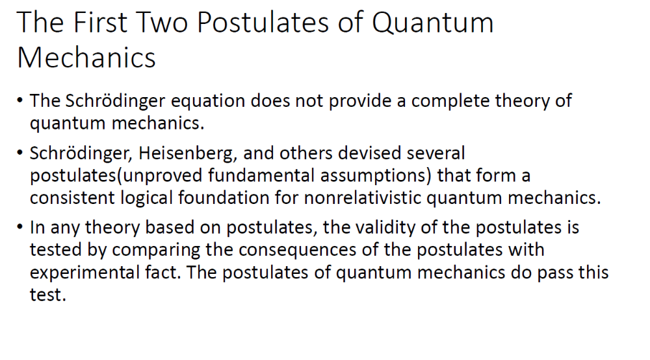

Slide 13


Postulates of Quantum Mechanics
Postulate 1:
State and wave functions. Born interpretation
The state of a quantum mechanical system is completely specified by a wave function ψ (r,t) that depends on the coordinates of the particles (r) and time t. These functions are called wave functions or state functions.
For 2 particle system:
Wave function contains all the information about a system.
wave function ⬄ classical trajectory
(Quantum mechanics) (Newtonian mechanics)
Meaning of wave function:
P(r) = |ψ|² =
=> the probability that the particle can be found at a particular point x and a particular time t. (Born’s / Copenhagen interpretation)

Slide 14
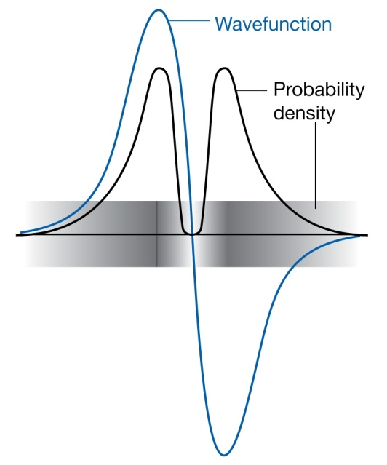
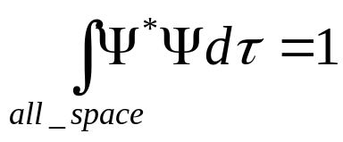
Implications of Born’s Interpretation
Positivity:
P(r) >= 0
The sign of a wavefunction has no direct physical significance:
The positive and negative regions of this wavefunction both
correspond to the same probability distribution.
(2) Normalization:
i.e. the probability of finding the particle in the universe is 1.

Slide 15
Physically acceptable wave function
The wave function and its first derivative must be:
Finite. The wave function must be single valued. This means that for any given values of x and t , Ψ(x,t) must have a unique value. This is a way of guaranteeing that there is only a single value for the probability of the system being in a given state.

Slide 16
2. Square-integrable
The wave function must be square-integrable. In other words, the integral of |Ψ|² over all space must be finite. This is another way of saying that it must be possible to use |Ψ|² as a probability density, since any probability density must integrate over all space to give a value of 1, which is clearly not possible if the integral of |Ψ|² is infinite. One consequence of this proposal is that must tend to 0 for infinite distances.

Slide 17
Continuous wavefunction
A rapid change would mean that the derivative of the function was very large (either a very large positive or negative number). In the limit of a step function, this would imply an infinite derivative. Since the momentum of the system is found using the momentum operator, which is a first order derivative, this would imply an infinite momentum, which is not possible in a physically realistic system.

Slide 18
Continuous First derivative
All first-order derivatives of the wave function must be continuous. Following the same reasoning as in condition 3, a discontinuous first derivative would imply an infinite second derivative, and since the energy of the system is found using the second derivative, a discontinuous first derivative would imply an infinite energy, which again is not physically realistic.

Slide 19
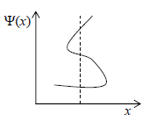
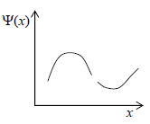
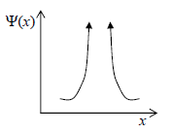
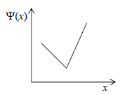
Acceptable or Not ??

Slide 20
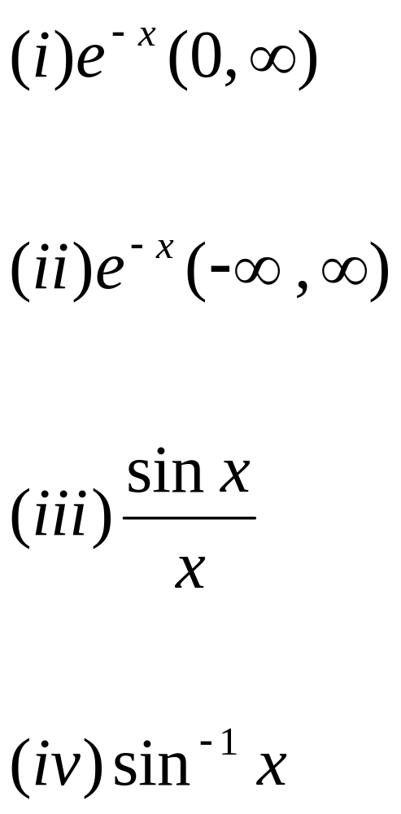
Acceptable or not acceptable ??

Slide 21
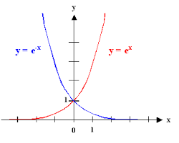
Exp(x)

Slide 22
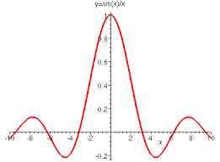
Sinx/x

Slide 23
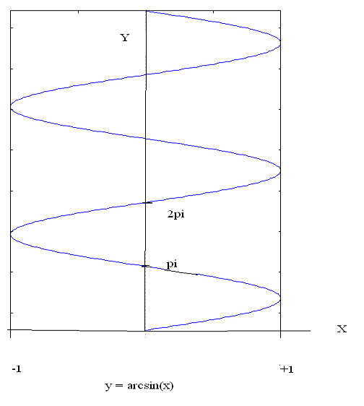
Sin⁻¹x

